Slide 1


IT Data Security Lecture Series
V Semester CSF
Dr. Narendra Kumar Dewangan
Assistant Professor, Senior Scale
Systems, School of Computer Sciences
UPES Dehradun
Data Security Threat Techniques

Slide 2

Contents
Denial of Service (DoS) and Distributed Denial of Service (DDoS) Attacks
Man-in-the-Middle (MITM) Attack:
Packet Sniffing (Eavesdropping)
Session Hijacking
IP Spoofing
DNS Spoofing
Rogue Access Points
Network Worms
ARP Spoofing (Address Resolution Protocol)
VLAN Hopping
Wireless Network Attacks
Botnets

Slide 3
Network-Based Threat Techniques
Denial of Service (DoS) and Distributed Denial of Service (DDoS) Attacks
Man-in-the-Middle (MITM) Attack:
Packet Sniffing (Eavesdropping)
Session Hijacking
DNS Spoofing
ARP Spoofing (Address Resolution Protocol)
IP Spoofing
Network Worms
Botnets
Wireless Network Attacks

Slide 4
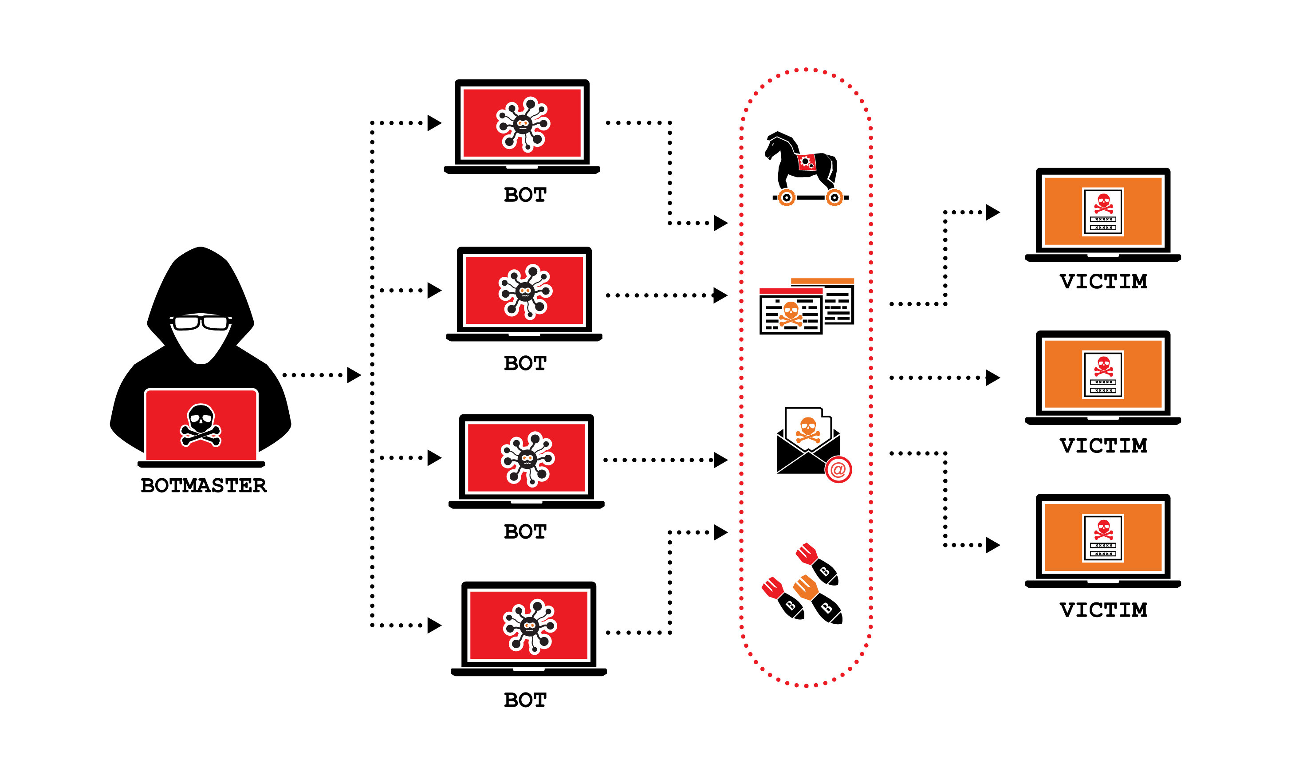
Denial of Service (DoS) and Distributed Denial of Service (DDoS) Attacks

Slide 5
Introduction
What is a Denial of Service attack?
Using up resources and / or bandwidth of a server in a malicious way to prevent legitimate users from accessing its services.
What is a DDoS?
A DoS attack carried out using a large number of compromised systems improving its potency and reducing traceability of the originator.
Some common DoS methodologies
SYN flood – exploits poor implementation of TCP in some OSs.
Ping of Death – uses inherent weakness in IP fragmentation and reassembly
Notorious DDoS attacks
MyDoom
Smurf attack

Slide 6
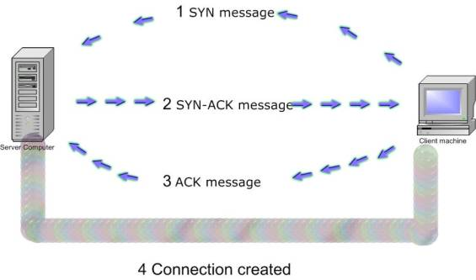
SYN Flood methodology

Slide 7
Ping of Death
Maximum legal size of IP packets is 65535 bytes.
Because of limitations in the physical layer, packets may have to be fragmented and then reassembled at the destination.
A fragmented packet with the maximum offset and size greater than 7 bytes will cause the server to allocate a buffer of size > 65535 bytes.

Slide 8
Distributed DoS attacks
Involves using some common DoS methodology, but the attack is carried out from a large number of machines
IP spoofing is a common technique used in almost all forms of attack.
Botnets consist of a large number of “zombie” machines controlled by a single user which can be used to carry out all sorts of attacks (including DDoS)
Network and protocol implementation loopholes can also be used for launching such attacks

Slide 9
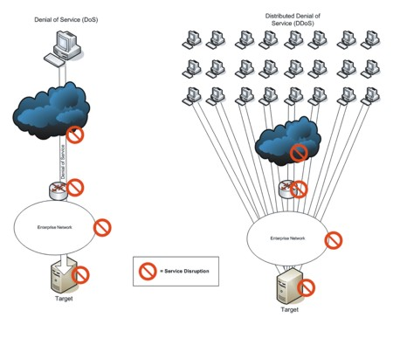
Distributed DoS attacks (contd.)
© Copyright 2008, WSTA, All Rights Reserved.

Slide 10
Notorious Attacks
Smurf attack:
A simple C program which spoofs the targets IP address and sends a broadcast ECHO (ICMP) message. All machines receiving the broadcast message ping the target machine, causing a massive DoS.
MyDoom: Fastest spreading email worm. On execution, opened a backdoor on the TCP 3127 port and could then be used to run DDoS attacks on specific domains. The affected domains were sco.com, microsoft.com, Google, AltaVista and Lycos

Slide 11
Techniques to mitigate Security Threats
Access Lists
NAT

Slide 12
Access Lists
Introduction
Purpose of Access Lists
Need for Access Lists
Definition
List of conditions

Slide 13
Detecting DOS attacks
How to determine if your system is under attack?
Show CPU utilization
Access-lists implementation

Slide 14
Commands (some examples)
access−list 111 permit ip 172.16.0.0 0.0.255.255 any
access−list 111 deny ip any any log
Interface serial 0/1
ip access−group 111 out

Slide 15
Prevention of DOS attacks
Cisco product ASA
Will be demonstrated in the simulation

Slide 16
Attacks mitigated by ALs
IP address spoofing
DOS smurf attacks
DOS sync attacks
Filtering traceroute

Slide 17
Network Address Translation
“Network Address Translation also known as IP Masquerading or NAT, is an Internet standard that enables translation of IP addresses used within one network to different IP addresses known within another network”

Slide 18
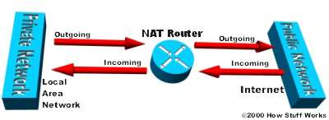
Need for NAT
Shortage of IP addresses with protocol IPv4
-IP address is a unique 32 bit number
-100 million of hosts & 350 million of users
-NAT comes into picture requires only single
IP address to represent a group of computers.

Slide 19
Types of NAT
Basic NAT :
Involves IP translation only - not port mapping
PAT (Port Address Translation):
Involves translation of both IP addresses & port numbers.
SNAT : Translation of Source IP address & port number
DNAT: Translation of Destination IP address & port number

Slide 20
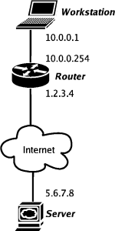
NAT Configuration

Slide 21
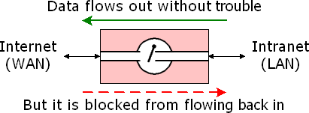
NAT Security Capabilities
Basic NAT acts as firewall between Internet & local Intranet, protects Intranet from Denial of service attack.
NAT routers having advanced firewall implements stateful packet inspection which allows filtering of unnecessary data like IP spoofing, SYN flooding from your router.
NAT router supporting port forwarding keeps unwanted traffic away from your local network.

Slide 22
Tools for DDoS Attacks
LOIC (Low Orbit Ion Cannon)
HOIC (High Orbit Ion Cannon)
Hping3

Slide 23
LOIC
LOIC performs a DoS attack by flooding the target with TCP, UDP, or HTTP requests. This can overwhelm the server’s resources like CPU, memory, and bandwidth – resulting in slow response or unavailability for legitimate users.
Here are some key features of LOIC:
Open-source tool available for Windows and Linux
Allows users to control rate and duration of attack
Supports UDP, TCP, and HTTP flooding attacks
Optional encryption via ZOMBIE messages
Built-in support for orchestrating attacks via IRC channels
User-friendly GUI and command-line interfaces

Slide 24
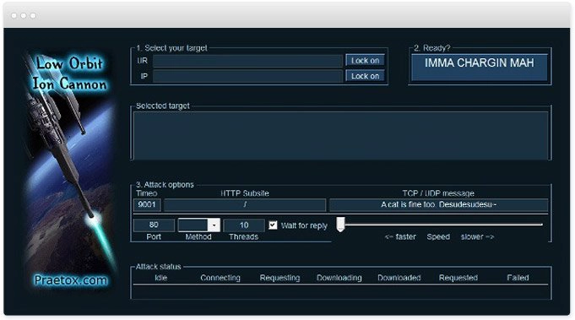
LOIC
Download https://sourceforge.net/projects/loic/

Slide 25
Working
LOIC works by sending a high volume of TCP, UDP, or HTTP requests to the target server. The exact working mechanism depends on the protocol used:
TCP Flood
A TCP flood attack establishes multiple half-open connections that consume resources on the target server waiting to complete the handshake. This can overwhelm networks and load balancers.
UDP Flood
In a UDP flood, LOIC sends a stream of UDP packets to random destination ports on the target. This can saturate the network capacity.
HTTP Flood
An HTTP flood sends continual HTTP GET or POST requests to specific URLs on the target website. This can consume web server resources or bandwidth.

Slide 26
Steps of Attack
Target Selection
The attacker selects a website, server or network to disrupt. Common targets are business sites, critical infrastructure, and government networks.
Weaponization
LOIC is downloaded and configured for the attack. Settings are tuned, including: attack duration, rate limits, and spoofing parameters.
Attack Launch
The attacker launches the LOIC tool against the target. For larger attacks, multiple LOIC instances and botnets are coordinated.
Attack Impact
The target experiences denial of service, unavailability of resources and services for end users. Financial, operational and reputational damages can occur.
Attack Stop
The attack is stopped by stopping the LOIC tool. Backup servers may be deployed to restore services. Forensics are done to trace the attack sources.

Slide 27
HOIC (High Orbit Ion Cannon)
HOIC is an application-layer attack tool. It is more advanced than LOIC and designed to work using only HTTP floods (unlike LOIC, which uses TCP/UDP floods as well), sending HTTP POST and GET requests. It can attack up to 256 domains or IP addresses simultaneously using a large number of threads. It is especially effective against thread-based web servers such as Apache, particularly those that are not configured to mitigate application-layer attacks such as Slowloris and R.U.D.Y.

Slide 28
DDoS attack using HOIC
A distribute denial of services (DDoS) attack involves a group of compromised systems usually infected with Trojans used to perform a DoS attack on a target system or network.
Objectives
Perform DDoS attack - HTTP flooding
Requisites
Kali Linux virtual machine (Target)
Windows Server, Windows 10 and Windows 7 virtual machine (Attackers)
Overview of HOIC
High Orbit Ion Cannon (HOIC) is a free, open-source network stress application developed by Anonymous, a hacktivist collective, to replace the Low Orbit Ion Cannon (LOIC). Used for denial of service (DoS) and distributed denial of service (DDoS) attacks, it functions by flooding target systems with junk HTTP GET and POST requests.

Slide 29
DDoS attack using HOIC
Log in to Virtual Machines
Before beginning this lab, turn on and log in to all virtual machines on this lab (Windows 7, 10, Server and Kali Linux).
Copy the High Orbit Ion Cannon (HOIC) folder onto all the Windows virtual machines(3).
Configure HOIC
Switch to the Windows 10 and open the HOIC (hoic2.1.exe)
On the HOIC GUI, click '+' to add the target.

Slide 30
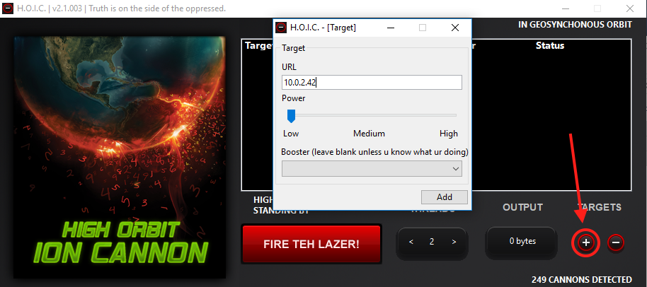
DDoS attack using HOIC

Slide 31
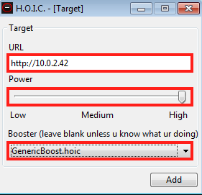
DDoS attack using HOIC
On the HOIC - [Target] pop-up:
Type the target URL (IP address of your Kali)
Slide the power bar to High
Select GenericBoost.hoic booster from the drop-down list
Click add

Slide 32
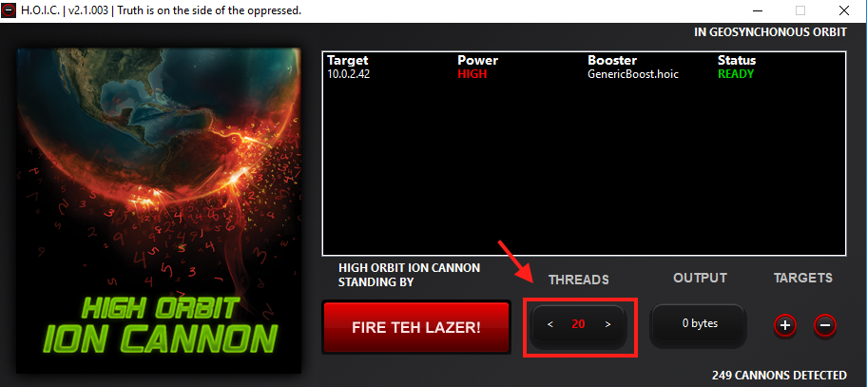
DDoS attack using HOIC
Set the THREADS value to 20 as shown below:

Slide 33

DDoS attack using HOIC
Now repeat this process on every Windows virtual machine on your lab.
Perform DDoS Attack
Once HOIC is configured on all machines, switch to each machine and click FIRE TEH LAZER!.
This initiates the DDoS attack on the target (Kali Linux).
Switch to the Kali Linux and launch the Wireshark.
Observe that Wireshark starts capturing a very large volume of packets, which means the machine is experiencing a huge number of incoming packets. These packets are coming from the Windows 7, Windows Server and Windows 10 virtual machines.

Slide 34
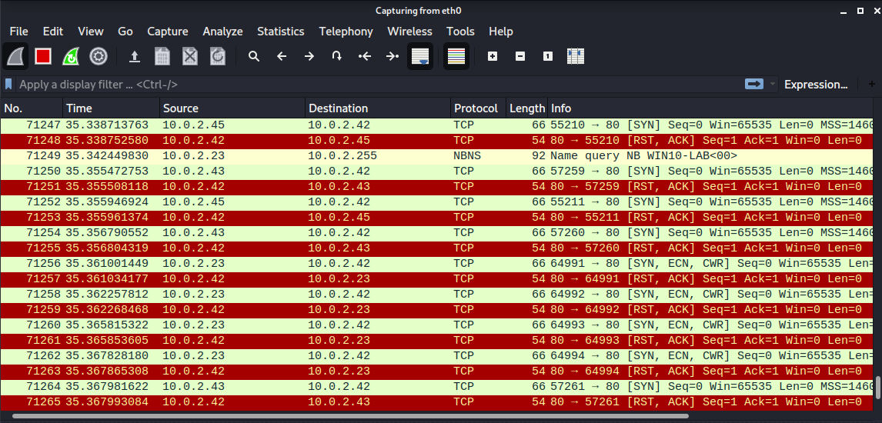
DDoS attack using HOIC

Slide 35
DDoS attack using HOIC
In real time, a group of hackers operating hundreds or thousands of machines configure this tool on their machines, and simulate the DDoS attack by flooding a target machine/website at the same time. The target is overwhelmed and stops responding to user requests or starts dropping packets coming from legitimate users. The larger number of attacker machines, the higher the impact of the attack on the target machine/webste.
To stop the DDoS, click FIRE TEH LAZER! again, and then close the HOIC window in all the attacker virtual machines

Slide 36
DDoS Attack using hpingg3
Run the command: hping3 --flood -S -V --rand-source http://stv.com
Where:
--flood send packets as fast as possible
-S (Syn packet): legit TCP packet connection
-V verbose mode
--rand-source randomize the IP source address, like it's requested from different systems (sort of DDoS)
Follow steps in
https://ravi73079.medium.com/attacks-to-be-performed-using-hping3-packet-crafting-98bc25584745

Slide 37
Man-in-the-Middle (MITM) Attack:
A MITM attack occurs when an attacker intercepts the communication between two parties without their knowledge, enabling the attacker to eavesdrop, modify, or steal information.

Slide 38
Introduction
What is MITM?
In cryptography and computer security, a Man-In-The-Middle Attack (MITM) also known as “Hijacking” is an attack where the attacker secretly relays and possibly alters the communication between two parties who believe they are directly communicating with each other.

Slide 39
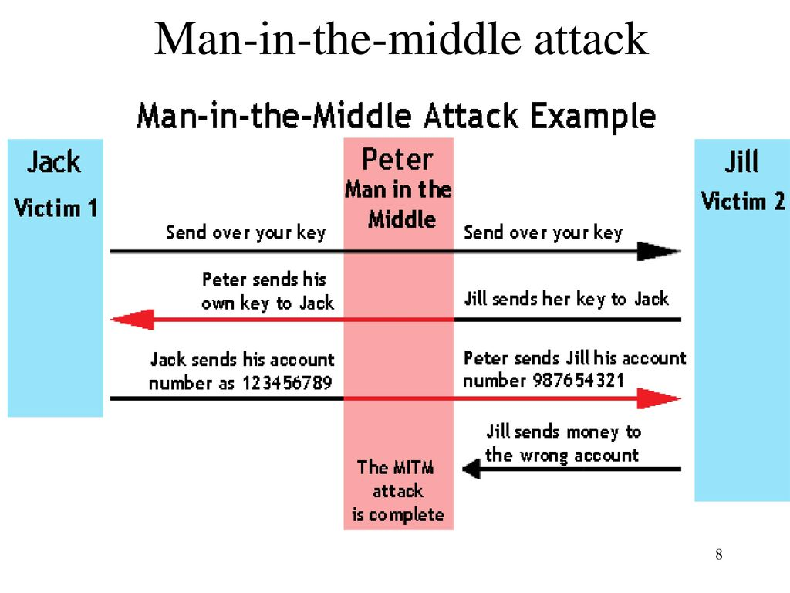
Simple Scenario

Slide 40
Types of MITM attacks
ARP Spoofing
DNS Poisoning
DHCP Spoofing
SSL stripping
Rogue Access Point
IP Spoofing
Email Hijacking
HTTPS Spoofing

Slide 41
ARP Spoofing
ARP: ARP stands for Address resolution protocol. It is basically a protocol used by the IP, specifically IPv4 to map IP addresses to MAC address used by a data link protocol.
Every System has an ARP table where they store information about what IP address is associated with what MAC address. While sending a packet to an IP, the system will first check the ARP table to see if it has MAC address associated with that IP. If it is not present then it will broadcast the IP address across the network asking for it’s corresponding mac address. Now the IP packet can be transferred successfully as source IP, MAC and Destination IP, MAC is known.
Command to check the arp table: arp –a

Slide 42
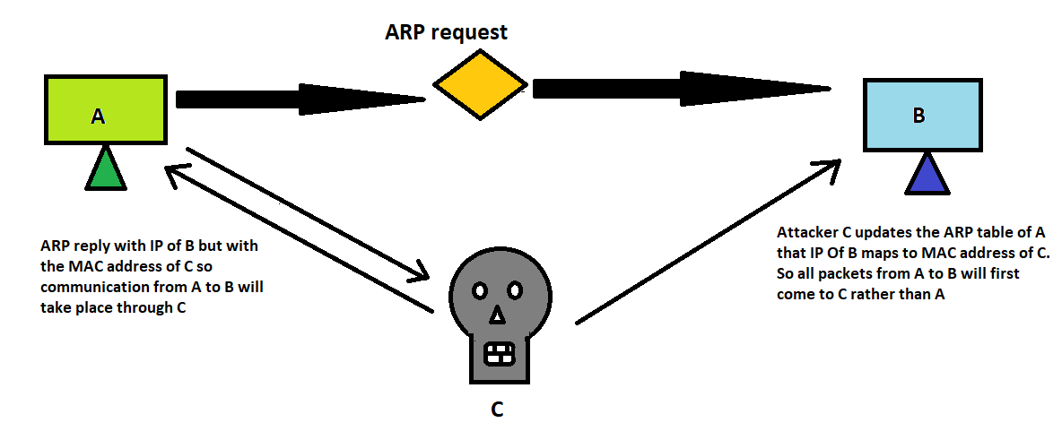
ARP Spoofing

Slide 43
ARP Spoofing
System A can send IP packets to B as the ARP Table of A has the IP address of B assigned to MAC address of B. So communication would take place.
But if the attacker C gives an ARP reply with the IP address of B but with the MAC address of itself (i.e. MAC address of C) and as ARP has no authentication mechanism, the A’s ARP table will be updated that the IP address of B maps to MAC address of attacker C.
So A on sending any packet to B, the packet will go to C. Now C can assign a forwarding mechanism that will forward the same packet from C to B thus initiating a Man in the middle attack where C will be in the middle and see all the requests.

Slide 44
ARP Spoofing
MITIGATIONS
Use a static ARP table
Always use a Virtual Private network while connecting to public Wifi

Slide 45
DNS Poisoning
DNS: The Domain Name System (DNS) is a central part of the Internet, providing a way to translates human readable domain names (for example, theblocksec.com) to machine readable IP addresses (for example, 51.80.12.44).
DNS poisoning/spoofing is a MITM technique used to supply false DNS information to a host so that when they attempt to browse, for example, www.bankofamerica.com at the IP address 52.78.90.43 they are actually sent to a fake www.bankofamerica.com residing at IP address 192.168.0.2 which an attacker has created in order to steal account information from unsuspecting users.

Slide 46
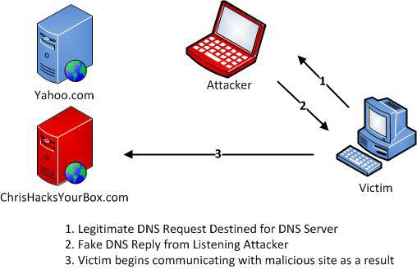
DNS Poisoning

Slide 47
DNS Poisoning
DNS Poisoning can be achieved in many ways but one of the most common methods is to use the Arp spoofing method to achieve DNS spoofing where in the attacker first conducts an arp spoof attack between the victim machine and the network gateway so that all the requests will travel via the attacker.
In a typical scenario, when the victim types in example.com it will first query the DNS server for DNS name translation but since it will go through the attacker, the attacker machine sends a fake DNS reply that the example.com maps to 192.168.0.2(IP address of the attacker).
This will eventually open the page hosted by the attacker in it’s own machine.

Slide 48
DNS Poisoning
MITIGATIONS
Use IDS: An intrusion detection system, when placed and deployed correctly, can typically pick up on most forms of ARP cache poisoning and DNS spoofing.
Use DNSSEC: DNSSEC is a newer alternative to DNS that uses digitally signed DNS records to ensure the validity of a query response. DNSSEC is not yet in wide deployment but has been widely accepted as "the future of DNS".

Slide 49
DHCP Spoofing
DHCP: The Dynamic Host Configuration Protocol (DHCP) is a network management protocol used on UDP/IP networks whereby a DHCP server dynamically assigns an IP address and other network configuration parameters to each device on a network so they can communicate with other IP networks
DHCP spoofing occurs when an attacker attempts to respond to DHCP requests and trying to list themselves (spoofs) as the default gateway or DNS server, hence, initiating a man in the middle attack.

Slide 50
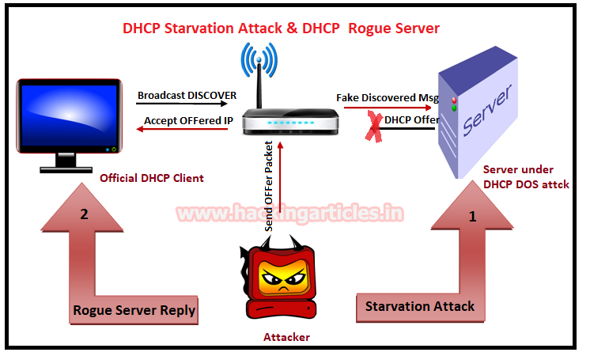
DHCP Spoofing

Slide 51
DHCP Spoofing
DHCP spoofing is usually achieved by a combination of both DHCP starvation and spoofing attack.
DHCP Starvation Attack:
In a DHCP starvation attack, an attacker broadcasts large number of DHCP REQUEST messages with spoofed source MAC addresses. If the legitimate DHCP Server in the network start responding to all these bogus DHCP REQUEST messages, available IP Addresses in the DHCP server scope will be depleted within a very short span of time.

Slide 52
DHCP Spoofing
DHCP Spoofing Attack:
After a DHCP starvation attack, a rogue DHCP server is set wherein the attacker can start distributing IP addresses and other TCP/IP configuration settings to the network DHCP clients. TCP/IP configuration settings include Default Gateway and DNS Server IP addresses. Network attackers can now replace the original legitimate Default Gateway IP Address and DNS Server IP Address with their own IP Address.
Once the Default Gateway IP Address of the network devices are is changed, the network clients start sending the traffic destined to outside networks to the attacker's computer. The attacker can now capture sensitive user data and launch a man-in-the-middle attack

Slide 53
DHCP Spoofing
MITIGATIONS
Port security: The techniques that mitigate CAM table flooding also mitigate DHCP starvation by limiting the number of MAC addresses on a switch port. You would use the port-security command to set the MAC address of a valid DHCP server on a switch port to prevent any other device from connecting to that trusted port.
DHCP snooping: DHCP snooping is a security feature that filters untrusted DHCP messages and builds and maintains a DHCP snooping binding table.

Slide 54
Tools to Perform MITM attack
Ettercap: Used for conducting MITM attacks by sniffing, injecting, and manipulating network traffic.
Wireshark: A packet analyzer that can capture and display data traveling over a network, useful for detecting MITM attacks.
Bettercap: An advanced MITM framework used for network monitoring, MITM attacks, and packet manipulation.

Slide 55
Lab objectives
After this lab we expect all of you to know:
what a MITM is,
what are the different types of MITM attacks and
how you can perform them using ettercap…
Lastly how to save your face from such attacks...

Slide 56
Lab Structure
Hands-On → Make yourself home
Listening (ARP Poisoning)
Modification (Downgrading of SSL and SSH)
Save your face with some countermeasures

Slide 57
Man-in-the-Middle

Slide 58
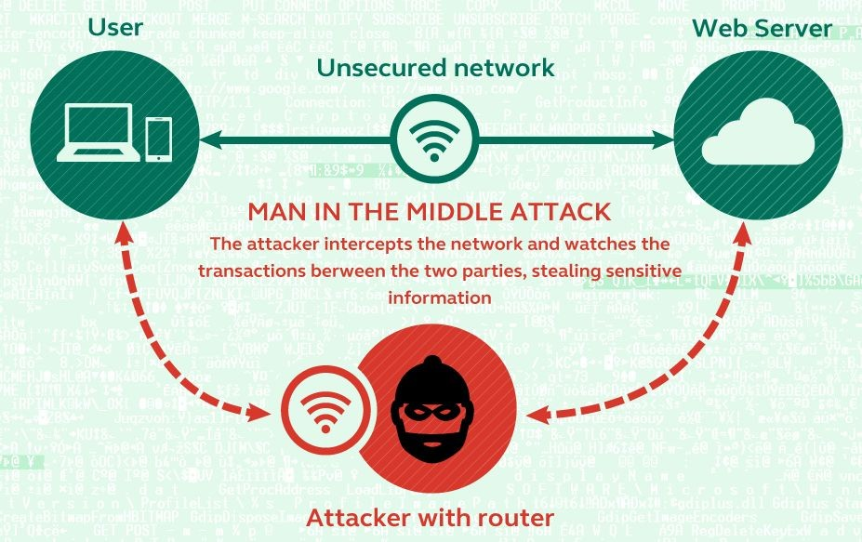

Slide 59

Lab setup
Alice (Client/Server)
Bob (Client/Server)
Eve (Eavesdropper)

Slide 60

Victim VM → Alice
- Victim VM → Lubuntu 15.10
- ifconfig
- It should be 192.168.56.7
- root password → 123

Slide 61
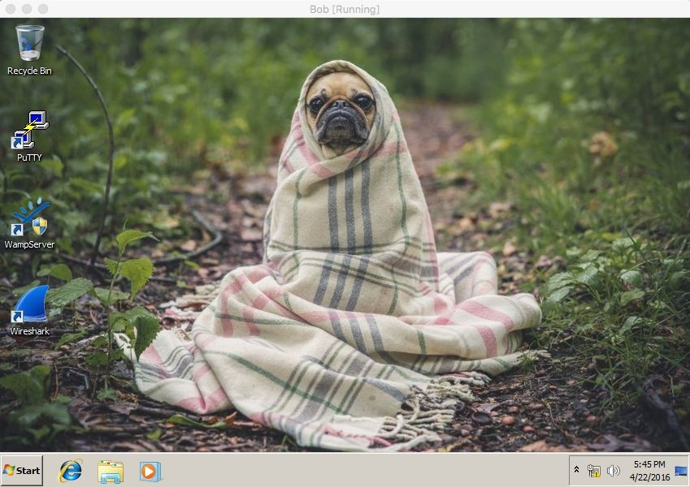
Victim VM → Bob
Victim VM → Windows 7
- Open the terminal
- ipconfig
- It should be 192.168.56.8
- Start the WampServer
- root password → 123

Slide 62

Attacker VM → Eve
- Attacker VM → Lubuntu 15.10
- ifconfig
- It should be 192.168.56.9
- root password → 123

Slide 63
Wireshark
sudo wireshark

Slide 64
WireShark
In attacker’s machine:
Open LxTerminal from desktop and type sudo wireshark
Check Interface with ifconfig in LxTerminal.
Select Interface in wireshark program (enp0s3)
Happy Sniffing
Filters (http/ssh)
Packets (GET/POST)

Slide 65
Wireshark

Slide 66
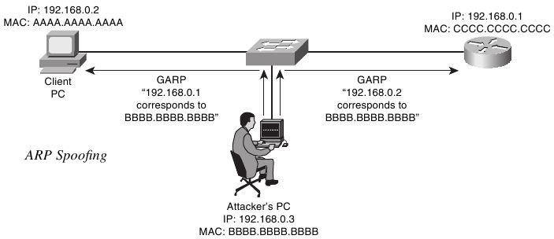
ARP Poisoning: Concept
An attacker associates his MAC address with the IP address of another host, causing any traffic meant for that IP address to be sent to the attacker instead.

Slide 67
ettercap
sudo ettercap -G

Slide 68
Overview Ettercap
Ettercap is a free and open source network security tool for man-in-the-middle attacks on LAN used for computer network protocol analysis and security auditing.
It:
intercepts and alters traffic on a network segment,
captures passwords,
Has powerful (and easy to use) filtering language that allows for custom scripting
conducts active eavesdropping against a number of common protocols: TELNET, FTP, POP, IMAP, rlogin, SSH1, ICQ, SMB, MySQL, HTTP, NNTP, X11, Napster, IRC, RIP, BGP, SOCKS 5, IMAP 4, VNC, LDAP, NFS, SNMP, Half-Life, Quake 3, MSN, YMSG!

Slide 69
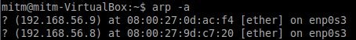
ARP Poisoning (1)
Check victims’ arp table before the attack
arp -a

Slide 70
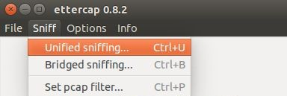
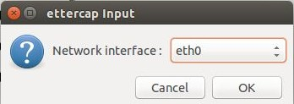
ARP Poisoning (2)
In attacker’s machine:
on menu bar, click Sniff, → Unified sniffing…
select the proper network interface enp0s3
click OK

Slide 71
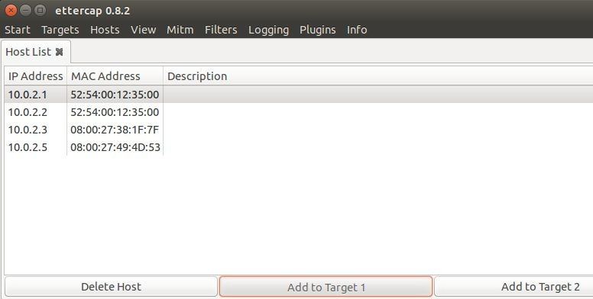
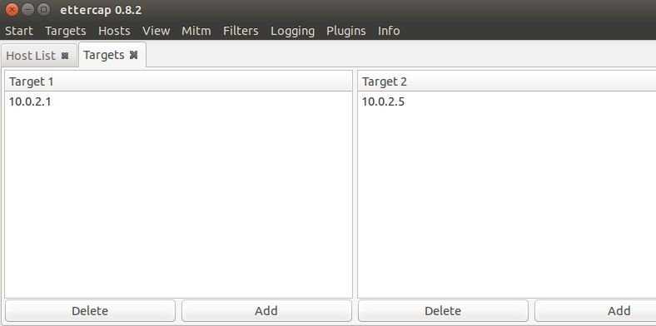
ARP Poisoning (3): attacker machine (cont.)
to show list of machines connected to the interface:
on menu bar, click Hosts → Scan for hosts
Hosts → Hosts list
to select the target for the attack
show hosts list
select server’s IP address, click Add to Target 1*
select victim’s IP address, click Add to Target 2*
to see our current target:
on menu bar, click Targets → Current targets
Here we can see both the IP address in their “boxes”.
*Can be viceversa. There is no concept of SRC or DST

Slide 72
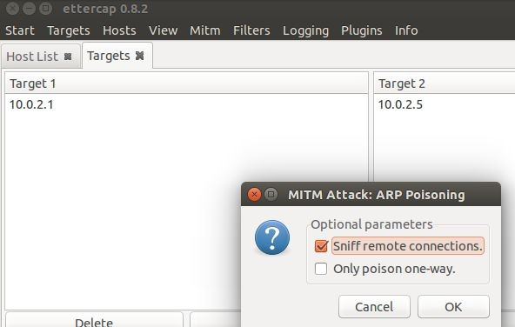
ARP Poisoning (4): attacker machine (cont.)
To perform the ARP poisoning attack:
on menu bar, click Mitm → ARP Poisoning…
check Sniff remote connections
click OK

Slide 73
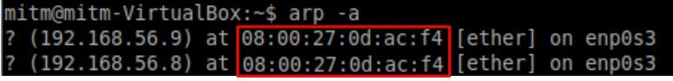
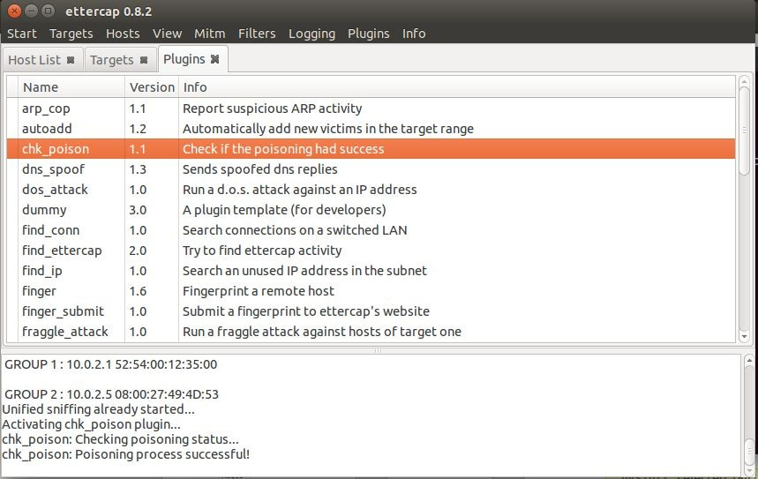
ARP Poisoning (5): Check ARP Tables
How do we know that we are successful to attack the victim?
Check victim’s ARP table
arp -a
victim’s machine has attacker’s MAC address for server’s IP
address
or use the chk-poison plugin in Ettercap
on menu bar, click Plugin
select chk-poison
look at what ettercap says on the lowerside window

Slide 74
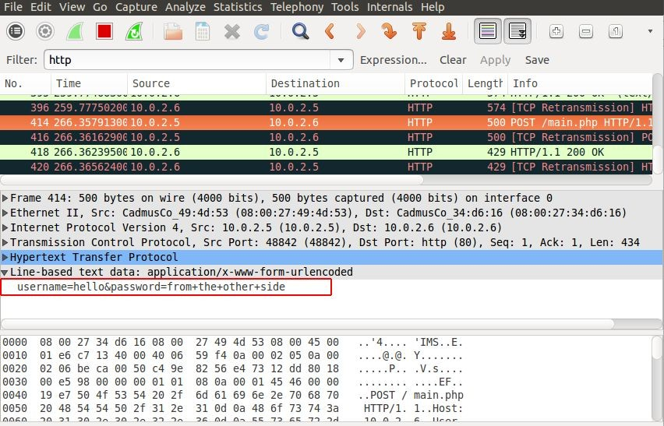
ARP Poisoning (6): Sniffing the conversation
In the attacker’s machine:
Clean previous WireShark’s results in your attacker’s machine
In the victim’s machine:
open browser
- go to page: 192.168.56.8/ab
Enter any firstname and lastname
Username and password can be directly be seen in clear by looking at the captured packets in Wireshark.
Look for POST in Info column to sniff firstname and lastname.

Slide 75
Let’s take a minute...
...and think how terrifying it is to know that you can be watched so easily while using networks like your home, or office or cafe…
But there is a good/bad news, that in real world a lot of our beloved known websites don’t work like this. They use https to secure the communication…
So as an attacker what would you do?

Slide 76
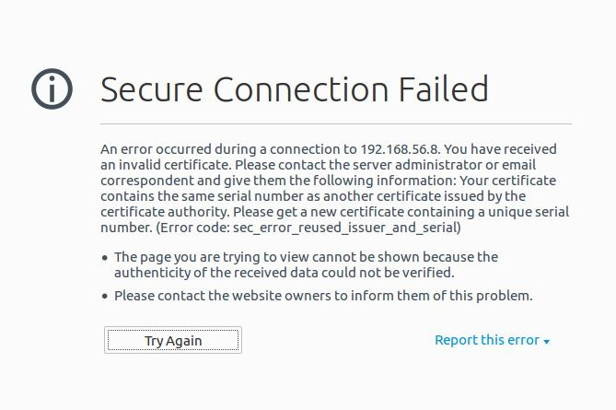
Example
In the victim’s machine:
open browser
go to page: 192.168.56.8/wordpress
go to the Login In
enter username and password
In the attacker’s machine:
- unlike before, we can’t see what victim has entered.

Slide 77
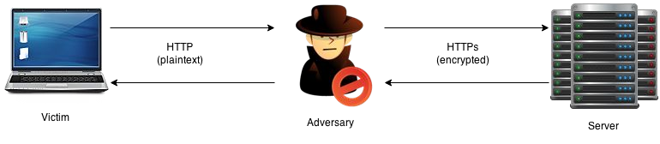
SSLStrip - Concept

Slide 78
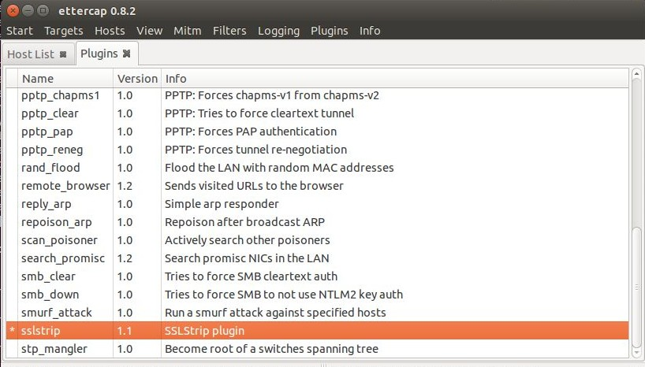
SSLstrip (1): attacker’s machine
In the attacker’s machine:
- activate SSLstrip plugin
on menu bar, click Plugins → Manage the plugins
double click on sslstrip plugins
there is (*) sign on the left side once it is activated

Slide 79
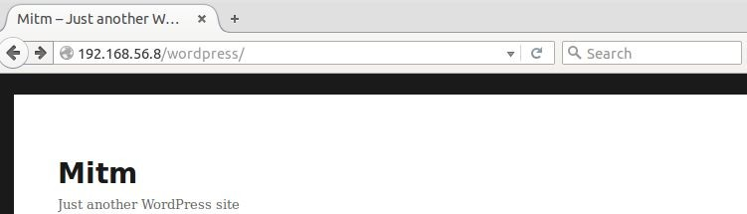
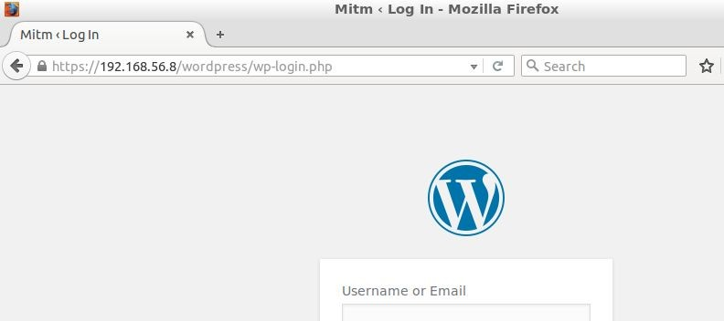
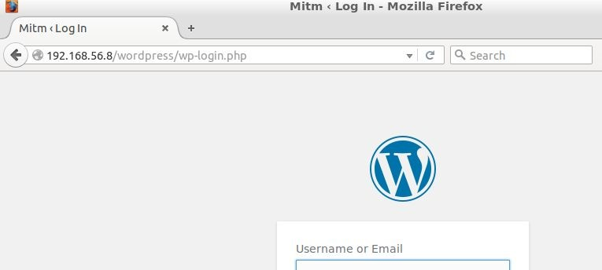
SSLstrip (2): victim’s machine
In the victim’s machine:
go to wordpress’s login page
Now, there is no error and it’s not going to be https, but http
Normal case: Browser redirects user to http page
SSLStrip: Converts https to http

Slide 80
SSLStrip (3): Sniffing conversation
Always in the victim’s machine:
- enter username and password
As before, on attacker’s machine:
- Wireshark will show the sniffed credentials

Slide 81
Ettercap Plugins

Slide 82
SSH Downgrade
This can be used once in "the man in the middle" position.
The principle is to downgrade a protocol version by changing data inside packets, to another version known to be vulnerable (such as SSH1 protocol).
The client sends a request to establish a SSH link to the server and asks it for the version it supports.
The server answers with either:
- ssh-2.xx | → | The server supports only SSH2
- ssh-1.99 | → | The server supports SSH1 and SSH2
- ssh-1.51 | → | The server supports only SSH1

Slide 83
SSH Downgrade - Example
In this example:
Alice is the ssh server
Bob is the ssh client (putty)
In Alice’s machine:
Open terminal
- Type telnet 192.168.56.7 22
Check if it’s running
If it’s not running: type /etc/init.d/ssh restart
Let try to connect it with putty from Bob.
Check Wireshark with ssh filter and you can see it’s version 2!

Slide 84
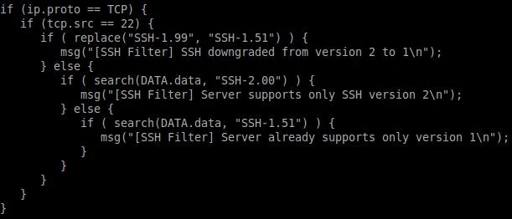
SSH Downgrade - Solution
In the attacker’s machine:
Open explorer
Go to /usr/share/ettercap
Copy etter.filter.ssh to Desktop
- Double click it.

Slide 85
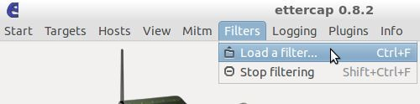
SSH Downgrade
Ettercap offers a predefined configuration file for the SSH downgrade attack.
In attacker’s machine:
- cd ~/Desktop
compile the file to create the filter by: etterfilter etter.filter.ssh -o etter.filter. ssh.co
load the filter: Filters --> Load a filter…
In the bob’s machine:
Perform the ssh from putty.

Slide 86
SSH Downgrade: countermeasures
How to avoid SSH downgrade attacks ?
SSH1 must NEVER be used on a SSH server and SSH2 forced on the client.
By default, only SSHv2 is enabled on the OpenSSH server while it is frequent to see SSHv1 and SSHv2 enabled on the clients such as Putty.
Let's see how we can secure the SSH client and server:
SSH server | → → | Open the /etc/ssh/sshd_config file Check that only the SSH2 protocol is enabled.
SSH client | → → | Open Putty Check that only SSH2 protocol is enabled.

Slide 87
ARP Poisoning - Countermeasures
Fighting effectively against ARP poisoning with efficiency is not an easy task because the ARP protocol provides no possibilities to establish the authenticity of the source of incoming packets.
Despite all, there are some ways to protect your machines against spoofers/poisoners by using:
- Static ARP
- Surveillance tools (such as Arpwatch, Ettercap or Snort IDS)

Slide 88
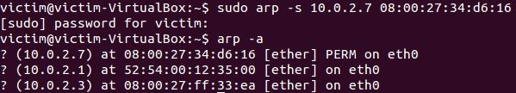
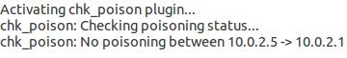
Static ARP
Static ARPing means that you manually configure IP to MAC mappings and are kept in the cache on a permanent basis (as for the communication with a known router).
So let’s configure the IP address of the Server in a static way.
In victim’s machine:
Open terminal
arp -s ip_server hw_address_server
Check victim’s arp table
- arp -a
- Check that flag is set as PERM
- Try to perform the arp poisoning attack with Ettercap
- Use chk_poison plugin

Slide 89
Packet Sniffing (Eavesdropping)
Description: Packet sniffing is the process of capturing and analyzing network packets to gather sensitive information such as credentials, cookies, or personal data.
Tools:
Wireshark: A powerful network protocol analyzer that captures network traffic and allows in-depth inspection of data packets.
Tcpdump: A command-line packet analyzer used for capturing and filtering network packets.
Cain & Abel: A Windows-based tool that includes a packet sniffing feature to intercept and analyze network traffic.

Slide 90
Sniffer Capabilities
Watch all network traffic over any Network Interface Card (NIC) connected to the host machine: TCP, IP, UDP, ICMP, ARP, RARP. Also port specific traffic: http, ftp, telnet,…
Forging ARP replies: intercept packets from target host(s) on the LAN intended for another host on the LAN: effective way of sniffing traffic on a switch
Passive sniffing: determine the local gateway of an unknown network – Data link layer (Hub)
Active Sniffing-Flood local network with random MAC addresses: switches will fail open in repeating mode, facilitating sniffing). This is no longer passive sniffing (Switch)
Password sniffing: minimally parsing each application protocol, and saving the "interesting" pieces
Sniffing HTTP traffic: output all requested URLs and do offline log analysis
Capture URLs from a client to local web browser for display URL, updated in real-time: when the target surfs, the local browser surfs
Notes:
Hub transmits line data to each port on the machine and has no line mapping. Switch looks at the MAC address associates with each frame passing through it and sends the data to the required port.
RARP – Reverse Address Resolution Protocol

Slide 91
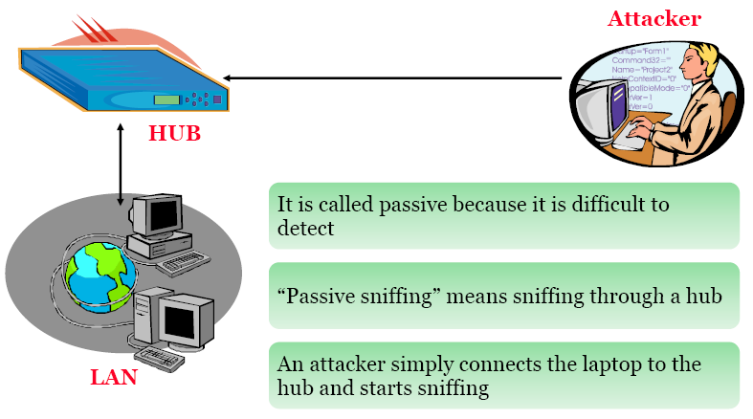
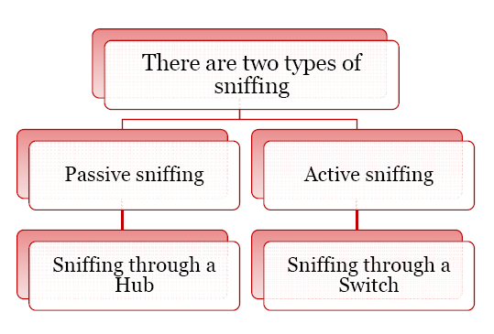
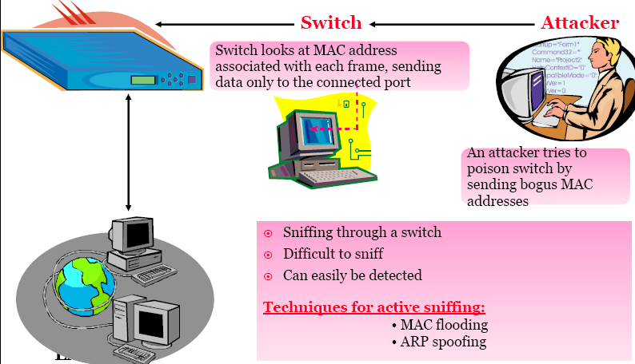

Slide 92
How Does a Sniffer Work ?
Packet sniffer must be on the same network as the originating or intended destination machine
Remote sniffing: install some Trojan or backdoor program on one of the computers on either the sending or receiving networks they may be able to do the packet sniffing remotely
Trojan: malicious program disguised as a normal application (perform a desirable function for the user prior to run or install but steals information or harms the system)
Backdoor: secret or undocumented means of getting into a computer system(is a method of bypassing normal authentication)

Slide 93
How Sniffer Works ? (1)
Most common way of networking computers – Ethernet
Computer connected to LAN has two addresses – MAC Address(uniqly identifies each node in a network & stored on Network card ), MAC is used by Ethernet protocol while building frames to transfer data to an from a system
IP Address – used by applications.
Data Link Layer uses an Ethernet header with the MAC address of the destination machine rather than IP address. The Network Layer is responsible for mapping IP network address to the MAC address as required by Data Link protocol.
It initially looks for the MAC addresses of the destination machine in a table- called as ARP cache

Slide 94
If no entry if found for the IP address, an ARP broadcast of a request packet goes out to all machines on the local sub-network.
The machine with that particular address responds to the source machine with its MAC address. This MAC address then gets added to the source machine ARP cache.
The source machine, in all its communication with the destination machine uses this MAC.

Slide 95
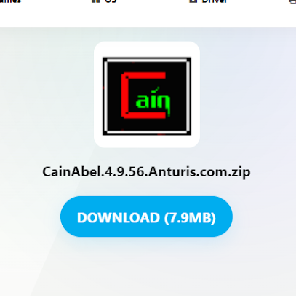
Cain and Abel
Steps to install and use this tool in windows:-
Step1:- Download the CainAbel zip file from any browser.

Slide 96
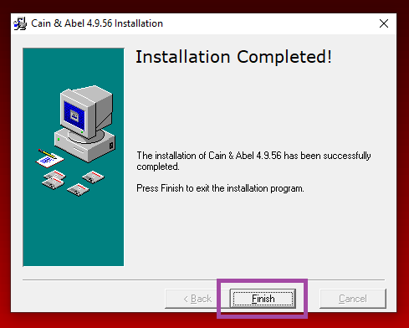
Step2:- Follow the installation instructions, proceeding by clicking “Next,” accepting the terms, and concluding by selecting “Finish” at the end.

Slide 97
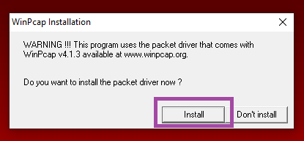
Step3:- To install this tool, you’ll also need WinPcap. Click “Install” and then follow the setup steps as instructed by the wizard.

Slide 98
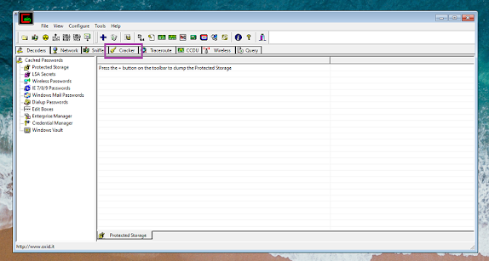
Step4:- Click on “Cracker”.

Slide 99
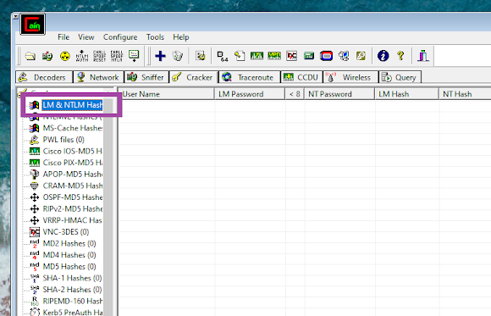
Step5:- Click the option “LM & NTLM Hashes”.

Slide 100
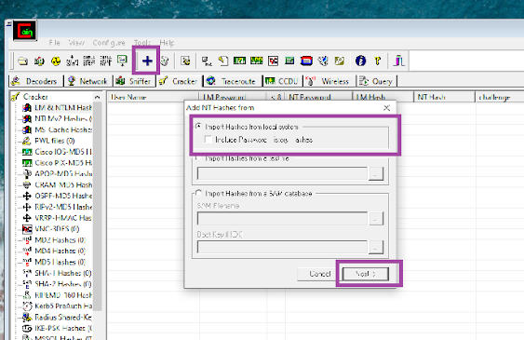
Step6:- Click on the “+” symbol, then select “Import Hashes.” Check the corresponding box and proceed by clicking “Next.”

Slide 101
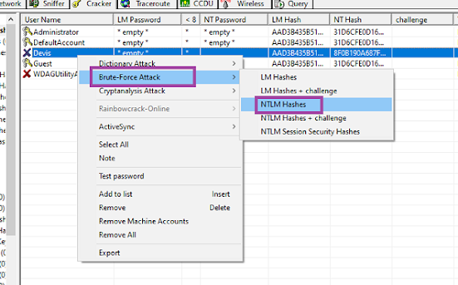
Step7:- Choose the account for which you want to crack the password. Right-click on it, then opt for a brute force attack. Within the attack options, select NTLM hashes.

Slide 102
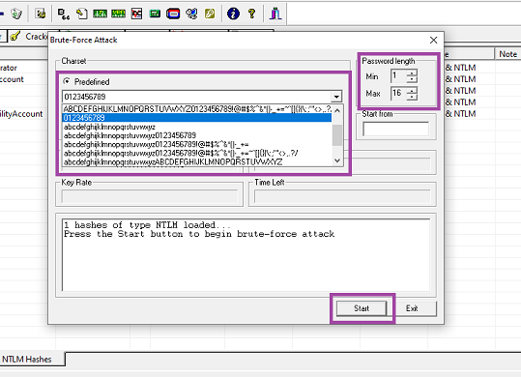
Step8:- Specify the Charset, Password length and then click on “Start”. It will start making combinations and take some time to crack hashes.

Slide 103
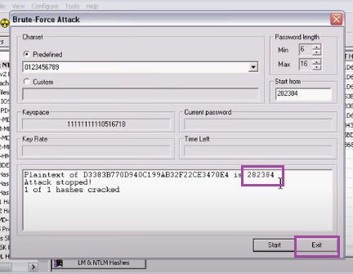
Step9:- Password cracked successfully.

Slide 104
Session Hijacking
Description: In session hijacking, an attacker takes control of a user session after successful authentication, usually by stealing the session token or cookies through techniques like MITM or packet sniffing.
Impact: Attackers can impersonate the legitimate user, gaining access to sensitive accounts, personal data, or privileged network resources.

Slide 105
Tools:
Wireshark: A network sniffer that can capture unencrypted session cookies over unsecured networks.
Cookie Catcher: A tool designed to intercept and manipulate session cookies for session hijacking.

Slide 106
What is Session Hijacking
TCP Connection Takeover
Takeover of a Web Application Session

Slide 107
State Management
HTTP is Stateless
Web Applications need state
User Logins
Shopping Carts

Slide 108
State Management, Cont’d
Client Side
Server Side
Golden Rule of Web Application Security
Cookies and Hidden Fields

Slide 109
Reasons for Session Hijacking
No Standards for Maintaining State
Session Tracking and State information at Client

Slide 110
How to Prevent Session Hijacking
Session Identifiers Should Be Unique
Session Identifiers Should Not be Guessable
Session Identifiers Should Be Independent
Session Identifiers Should be Mapped with Client-Side Connections

Slide 111
Cookie Catcher
https://github.com/DisK0nn3cT/CookieCatcher?tab=readme-ov-file

Slide 112
IP Spoofing
Description: IP spoofing involves sending network packets from a false IP address, tricking the receiving system into believing that the packet is from a trusted source. This technique is often used in conjunction with other attacks like DoS or MITM.
Impact: Can bypass security measures such as firewalls and access control lists, potentially leading to unauthorized access and data theft.

Slide 113
Tools:
Hping3: A tool that can manipulate IP headers and send packets with spoofed IP addresses for testing and attack purposes.
Scapy: A Python-based tool for creating and sending custom network packets, often used for IP spoofing.
Nemesis: A command-line network packet crafting tool used for IP spoofing and testing vulnerabilities.

Slide 114
Scapy
sudo pip3 install scapy
>>> from scapy.all import * >>> a = IP() ➀ >>> a.dst = ’10.0.2.3’ ➁ >>> b = ICMP() ➂ >>> p = a/b ➃ >>> send(p) ➄ . Sent 1 packets.

Slide 115
Nemesis
sudo nemesis tcp -v -S 192.168.1.1 -D 192.168.2.2 -fSA -y 22 -P foo
sudo nemesis udp -v -S 10.11.12.13 -D 10.1.1.2 -x 11111 -y 53 -P bindpkt
sudo nemesis icmp -S 10.10.10.3 -D 10.10.10.1 -G 10.10.10.3 –qR
sudo nemesis arp -v -d ne0 -H 0:1:2:c0:ff:ee -S 10.11.30.5 -D 10.10.15.1
sudo nemesis arp -v -r -d eth0 -S victim -D gateway -h myMAC
https://troglobit.com/projects/nemesis/

Slide 116
DNS Spoofing
DNS spoofing involves corrupting the DNS cache of a server or client, redirecting legitimate users to malicious websites. Attackers inject fake DNS responses to reroute traffic.
Tools:
Ettercap: In addition to its MITM capabilities, Ettercap can be used to perform DNS spoofing by manipulating DNS requests and responses.
Dsniff: A collection of network auditing and penetration testing tools, including the capability to conduct DNS spoofing attacks.
DNSChef: A tool for spoofing DNS responses, often used by penetration testers to manipulate DNS queries during assessments.

Slide 117
Dsniff:
># ./dsniff –i eth0 –w sniffed.txt
># dsniff: listening on eth0.
Follow steps is : https://www.giac.org/paper/gcih/68/dsniff-switched-network-switching/103678#:~:text=Using%20Dsniff%20And%20its%20Utilities&text=To%20start%20Dsniff%20for%20capturing,%23%20dsniff%3A%20listening%20on%20eth0.

Slide 118
DNS Chef
dnschef — fakeip 10.10.110.10 test.com
dnschef — fakeip 10.10.10.10 — fhost test.com — rhost 20.20.20.20
dnschef — fakeip 10.10.10.10 — file /path/to/domains.txt — response ‘127.0.0.1’
dnschef -f 192.168.0.10 -r “192.168.0.20” -q -qf -p -s -i eth0
dnschef -f 10.10.10.10 -d “test.com,test.net” -r “20.20.20.20” -q -qf -p -s -i eth0
dnschef -f 10.10.10.10 -r “20.20.20.20” -R -q -qf -p -s -i eth0
dnschef -f 10.10.10.10 -r “20.20.20.20–20.20.20.30” -q -qf -p -s -i eth0

Slide 119
ARP Spoofing (Address Resolution Protocol
ARP spoofing is an attack where an attacker sends falsified ARP messages to link their MAC address with the IP address of a legitimate device on the network, intercepting traffic meant for that device.
Tools:
Arpspoof: A tool used to carry out ARP spoofing attacks by sending fake ARP replies on the network.
Ettercap: Capable of performing ARP spoofing alongside its MITM functionalities.
Cain & Abel: A tool that can conduct ARP spoofing, intercepting traffic on a network by spoofing ARP messages.

Slide 120
ARPSpoof

Slide 121
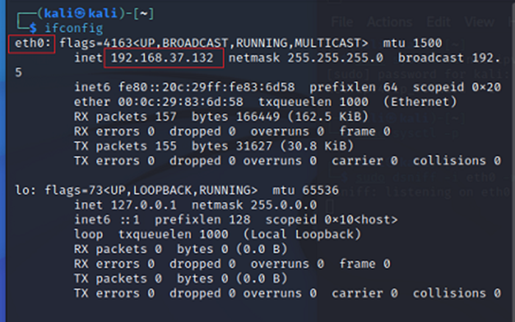
Steps to perform ARP Spoffing using arpspoof tool:- →Use command “ifconfig” to find the network interface and system ip.

Slide 122

→Use command arp -n to find all available host ips.

Slide 123

Step3:- Perform ARP spoofing. →To perform ARP spoofing use command “arpspoof -i <interface> -t <host_ip> <system_ip>”

Slide 124

Step4:- Saving captured traffic. →Once the ARP spoofing is in effect, you can save the intercepted traffic in text file using the command:”tcpdump -i <interface> -l > captured_traffic.txt”.

Slide 125

→Here we have the saved text file.

Slide 126
Network Worms
Network worms are self-replicating malware that spread across networks without user intervention. They exploit vulnerabilities in network services to infect multiple systems, often leading to the complete compromise of network resources.
Impact: Depletion of network resources, data corruption, system downtime, and the spread of malware across network devices.

Slide 127
Botnets
Description: Botnets are networks of compromised devices that attackers remotely control. Botnets are often used to launch DDoS attacks, send spam, or perform distributed network scanning.
Impact: Large-scale disruptions to services, data breaches, and involvement in illegal activities without the knowledge of the system owners.

Slide 128

How The Botnet Grows

Slide 129

How The Botnet Grows

Slide 130

How The Botnet Grows

Slide 131

How The Botnet Grows

Slide 132
Recruiting New Machines
Exploit a vulnerability to execute a short program (exploits) on victim’s machine
Buffer overflows, email viruses, Trojans etc.
Exploit downloads and installs actual bot
Bot disables firewall and A/V software
Bot locates IRC server, connects, joins
Typically need DNS to find out server’s IP address
Authentication password often stored in bot binary
Botmaster issues commands

Slide 133

Recruiting New Machines

Slide 134

What Is It Used For
Botnets are mainly used for only one thing

Slide 135
How Are They Used
Distributed Denial of Service (DDoS) attacks
Sending Spams
Phishing (fake websites)
Addware (Trojan horse)
Spyware (keylogging, information harvesting)
Storing pirated materials

Slide 136
Example : SDBot
Open-source Malware
Aliases
Mcafee: IRC-SDBot, Symantec: Backdoor.Sdbot
Infection
Mostly through network shares
Try to connect using password guessing (exploits weak passwords)
Signs of Compromise
SDBot copies itself to System folder - Known filenames: Aim95.exe, Syscfg32.exe etc..
Registry entries modified
Unexpected traffic : port 6667 or 7000
Known IRC channels: Zxcvbnmas.i989.net etc..

Slide 137
Example : RBot
First of the Bot families to use encryption
Aliases
Mcafee: W32/SDbot.worm.gen.g, Symantec: W32.Spybot.worm
Infection
Network shares, exploiting weak passwords
Known s/w vulnerabilities in windows (e.g.: lsass buffer overflow vulnerability)
Signs of Compromise
copies itself to System folder - Known filenames: wuamgrd.exe, or random names
Registry entries modified
Terminate A/V processes
Unexpected traffic: 113 or other open ports

Slide 138
Example : Agobot
Modular Functionality
Rather than infecting a system at once, it proceeds through three stages (3 modules)
infect a client with the bot & open backdoor
shut down A/V tools
block access to A/V and security related sites
After successful completion of one stage, the code for the next stage is downloaded
Advantage?
developer can update or modify one portion/module without having to rewrite or recompile entire code

Slide 139
Example : Agobot
Aliases
Mcafee: W32/Gaobot.worm, Symantec: W32.HLLW.Gaobot.gen
Infection
Network shares, password guessing
P2P systems: Kazaa etc..
Protocol: WASTE
Signs of Compromise
System folder: svshost.exe, sysmgr.exe etc..
Registry entries modification
Terminate A/V processes
Modify %System\drivers\etc\hosts file
Symantec/ Mcafee’s live update sites are redirected to 127.0.0.1

Slide 140
Example : Agobot
Signs of Compromise (contd..)
Theft of information: seek and steal CD keys for popular games like “Half-Life”, “NFS” etc..
Unexpected Traffic: open ports to IRC server etc..
Scanning: Windows, SQL server etc..

Slide 141

Thank you

